Slide 1
Wasatch Commons Reserve Analysis
2017

Slide 2
What is a Reserve Analysis?
"Reserve analysis" means an analysis to determine:
  (i) the need for a reserve fund to accumulate reserve funds; and
  (ii) the appropriate amount of any reserve fund.
Purpose:
  provide a budgeting tool to help ensure adequate reserve funds are available to perform future reserve projects

Slide 3
Reserve Funds:
money to cover the cost of repairing, replacing, or restoring common areas and facilities that have a useful life of three years or more and a remaining useful life of less than 30 years, if the cost cannot reasonably be funded from the general budget or other funds of the association of unit owners
Notes:
Operating Fund: funded from HOA dues, used for regular, yearly expenses (maintenance, insurance, taxes, etc.)

Slide 4
Utah Code 57-8-7.5: Reserve analysis
(2) Except as otherwise provided in the declaration, a management committee shall:
  (a) cause a reserve analysis to be conducted no less frequently than every six years; and
  (b) review and, if necessary, update a previously conducted reserve analysis no less frequently than every three years

Slide 5
Complex Solutions – Dale Gifford
14 years HOA experience
Professional Reserve Analyst (PRA)
Prepared over 1,100 reserve analysis in Utah
Cost: $1,500
Notes:
Site visit (physical inspection), component list, reserve fund analysis

Slide 6
Summary
Projected Starting Balance as of 01/2018 | $55,300
Ideal Reserve Balance as of 01/2018 | $192,503
Percent Funded as of 01/01/2018 | 29%
Recommended Reserve Contribution (per month) | $2,640
Minimum Reserve Contribution (per month) | $2,405
Recommended Special Assessment | $0
Notes:
Increase reserve contribution from $24,255/year to $31,680/year

Slide 7
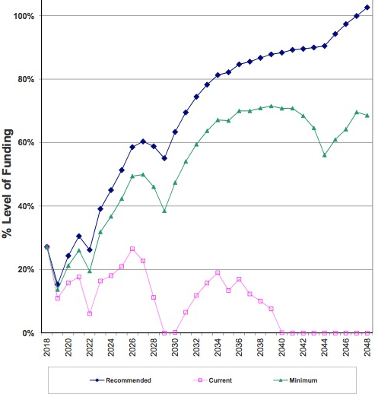
Percent Funded
Notes:
Fully Funded: necessary to avoid special assessments, prevent deferred maintenance

Slide 8
Yearly Summary
Year | Fully Funded Balance | Starting Reserve Balance | % Funded | Reserve Contributions | Reserve Expenses | Ending Reserve Balance
2018 | $204,026 | $55,300 | 27% | $31,680 | $60,930 | $26,091
2019 | $170,375 | $26,091 | 15% | $32,630 | $13,720 | $45,037
2020 | $185,031 | $45,037 | 24% | $33,609 | $19,096 | $59,602
2021 | $195,300 | $59,602 | 31% | $34,618 | $47,971 | $46,302
2022 | $176,867 | $46,302 | 26% | $35,656 | $1,126 | $80,897
2023 | $206,885 | $80,897 | 39% | $36,726 | $18,264 | $99,448
2024 | $220,927 | $99,448 | 45% | $37,828 | $13,815 | $123,572

Slide 9
2018 Recommended Expenditures
Roofs | $15,000
Rain Gutters | $1,000
Wood Trim – Repaint | $26,000
Doors – Repaint | $3,600
Wood Surfaces – Stain | $3,250
Carports – Repaint | $4,000
Asphalt – West – Seal | $1,880
Carpeting - Replace | $6,200
Total: $60,930

Slide 10
2018 Budget Implications
Recommended reserve contribution: $31,680
  Up 30% from 2017 ($24,255)
  Recommended 3% annual increase for 30 years
Notes:
Starting point for the budget is (a) increasing the reserve funding to recommended annual levels; (b) continuing the investment in property maintenance and landscaping at adequate levels to avoid higher costs in reserve or operating budgets in subsequent years; and (c) meeting the various committee budget requests. The challenge is how to balance the income and the expenses, and the 2018 proposal contains 2 possible approaches

